Slide 1

Predicting Life Satisfaction using Machine Learning
AKM Muntasir Uddin Shawon
ID: 2222450642
Mushfiq Azam
ID: 2222668042
Ahnaf Nabil
ID: 2212051042
Tanbir Islam
ID: 2222621042

Slide 2
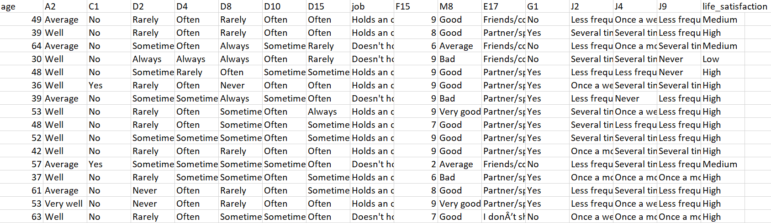
Dataset Info
(Public Dataset)
18958 Unique data.
From Kaggle

Slide 3

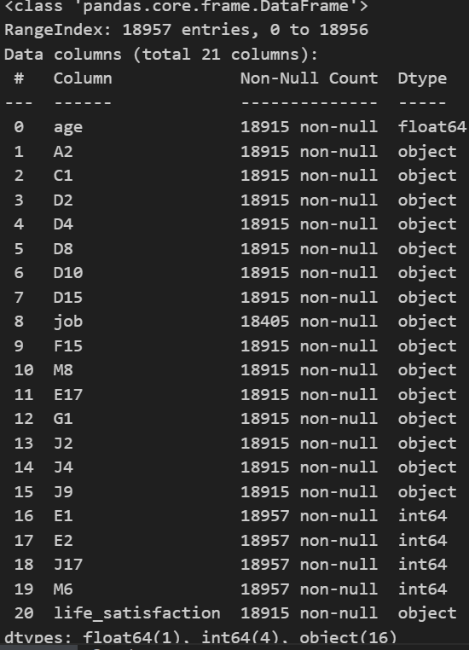
Data Insight(using df.info)
We can see that there are 511 null values in the job and so on.

Slide 4
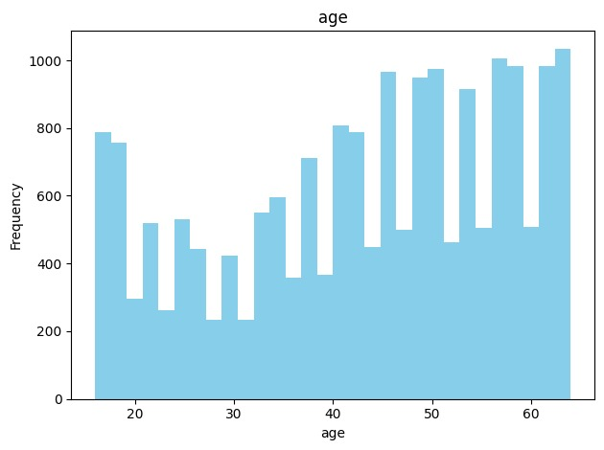
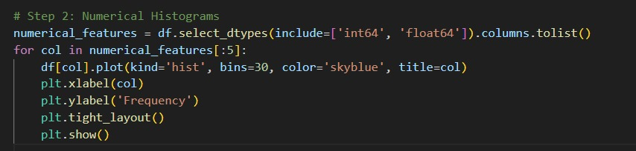
Individual Histogram for the numerical features
The age distribution is slightly right-skewed, with a large concentration of individuals in the 20–30 age range. Fewer participants are observed in older age groups, and very few are above the age of 60. This indicates that the dataset is primarily composed of young adults, which may influence life satisfaction trends and model outcomes.
Observation

Slide 5
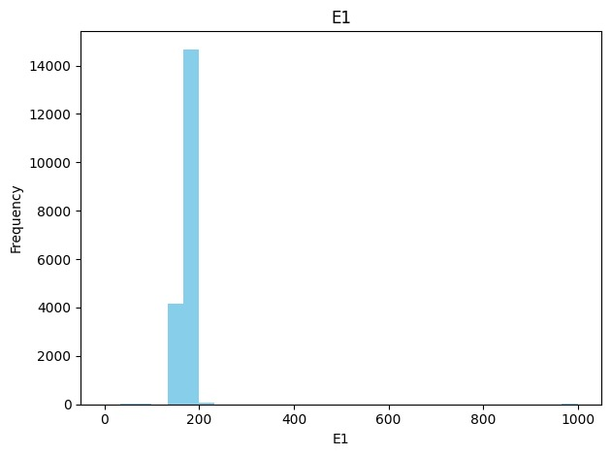
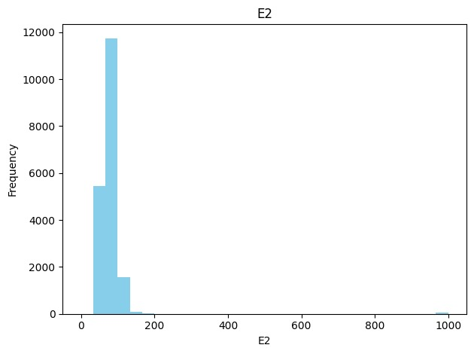
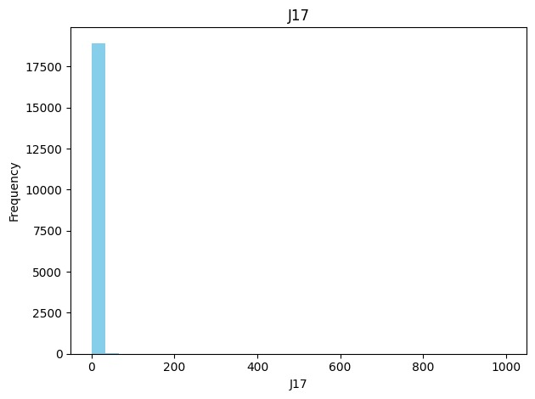
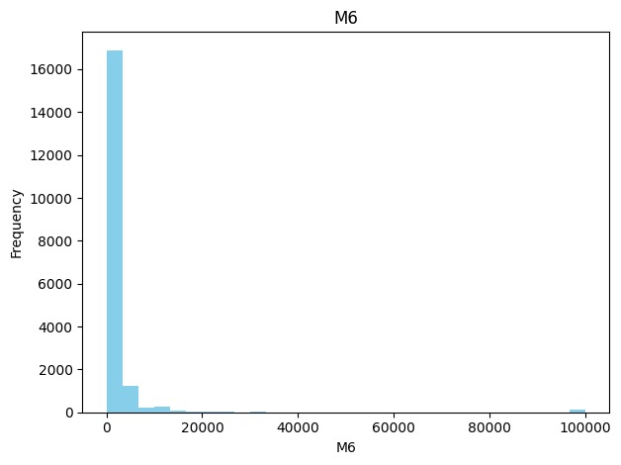
Individual Histogram for the numerical features
E1: How tall are you? (number of centimeters)
E2: How much do you weigh? (kilos)
J17: How often have you been abroad on holiday or family visits in the past year?
M6: In the past year, how much have you spent on medicine, nutritional supplements?

Slide 6
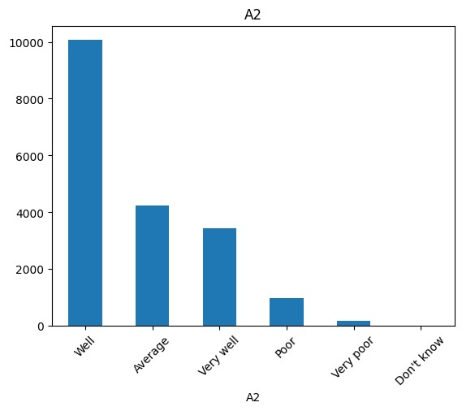
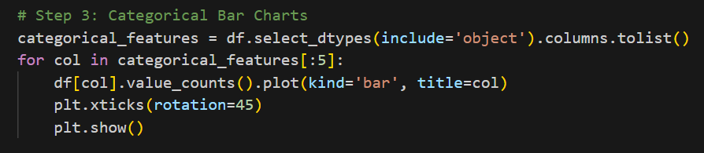
Individual bar chart for the categorical features
Most categorical features show an uneven distribution. For example, features like A2 and D2 have one or two dominant categories, suggesting potential class imbalance. This skewed distribution could impact model learning and may require techniques like encoding and balancing. Additionally, popular categories might reflect common demographic or social traits in the dataset.
Observation
A2: How would you rate your health generally?

Slide 7
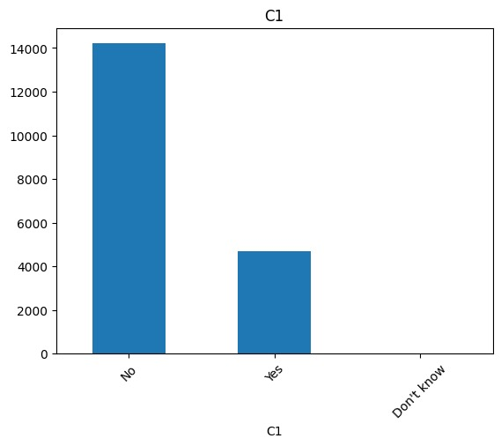
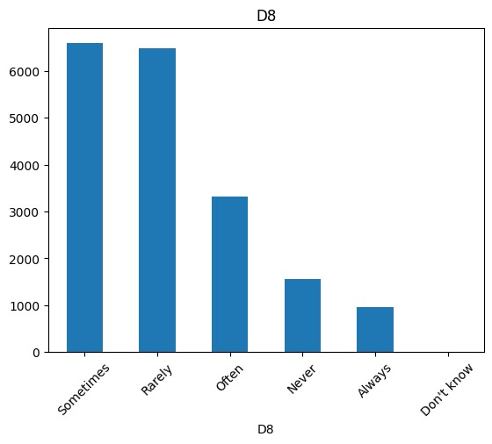
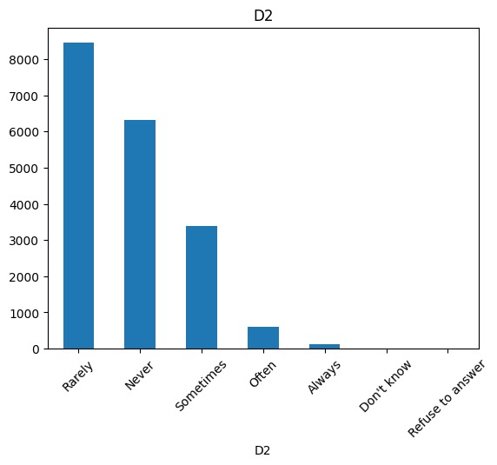
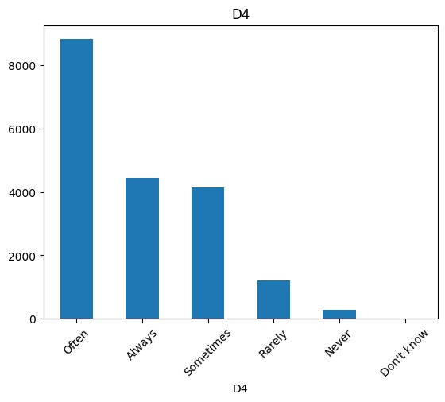
Individual bar chart for the categorical features
D2: Are you depressed?
C1: Do you suffer from a long-term physical health problem or disability?
D8: Do you see yourself as a person who worries a lot?
D4: Do you see yourself as a person who is relaxed and handles stress well?

Slide 8
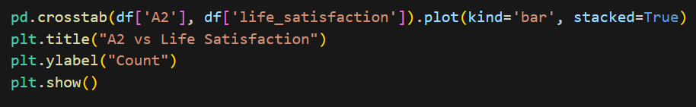
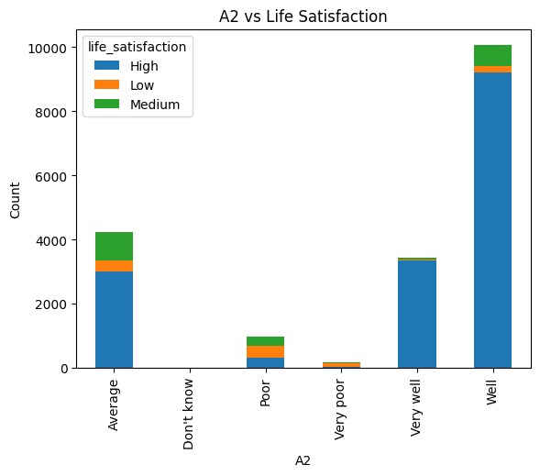
Bar plot for Categorical vs categorical
The "A2 vs life satisfaction" bar chart shows how different categories in the A2 column (How would you rate your health generally?) are distributed across life satisfaction levels. It helps you understand how life satisfaction varies by A2 group.
Observation

Slide 9
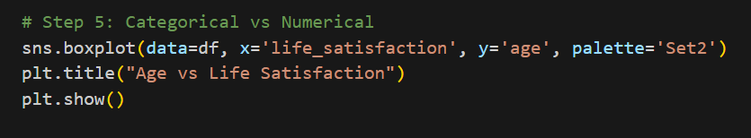
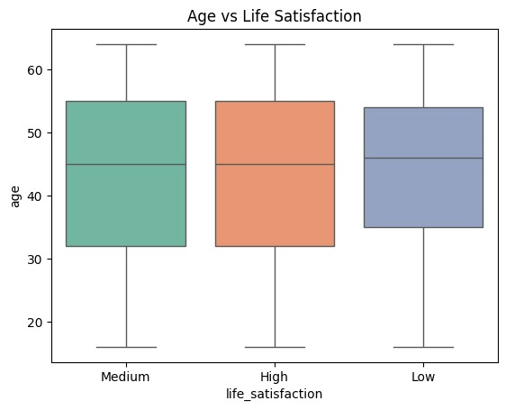
Categorical vs Numerical
The boxplot shows that the average age slightly varies across different life satisfaction levels. Some higher satisfaction categories include slightly older individuals, while lower satisfaction levels have a wider age range with more outliers. However, there is no strong linear trend, indicating that age alone may not be a strong predictor of life satisfaction.
Observation

Slide 10
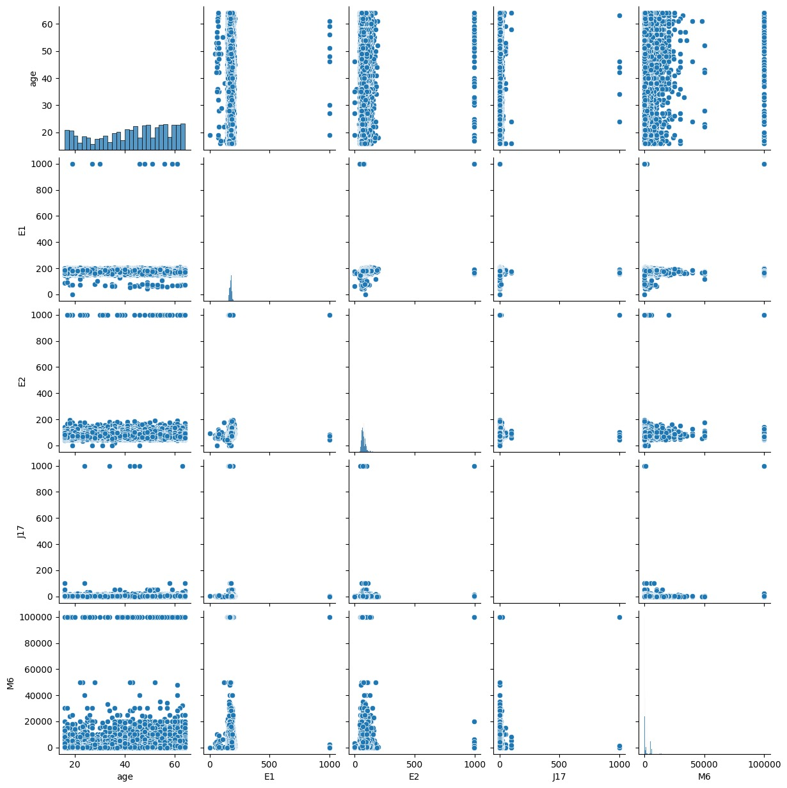
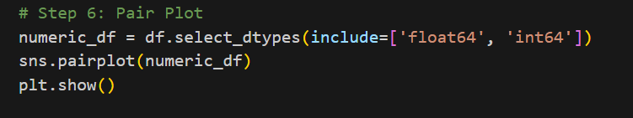
Numerical vs Numerical pair plot
The pair plot shows the relationship between numerical features (e.g., age and random_score). The scatter distribution appears mostly scattered without a clear linear pattern, suggesting low correlation between these variables. However, it helps in identifying clusters and potential outliers that could influence model performance.
Observation

Slide 11

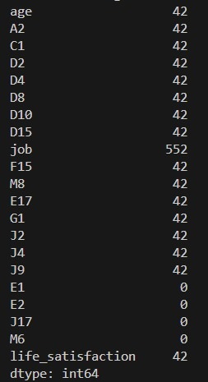
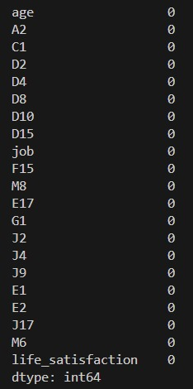
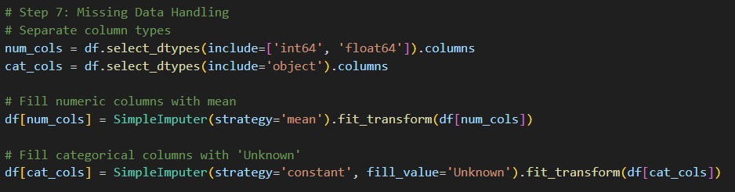

Missing data handling
Missing values were found primarily in the 'job' feature. These were handled using simple imputation by replacing nulls with the category "Unknown". This approach preserves all records without data loss and maintains model readiness while ensuring the integrity of categorical analysis.
We can see there are many null values
There is no null value after handling missing data

Slide 12
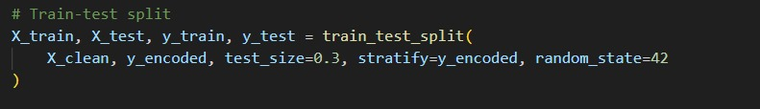
Stratified sampling on imbalanced class
Stratified sampling ensures that the class distribution of the target variable (life_satisfaction) remains consistent in both training and testing sets. This is especially important for imbalanced datasets, where some classes are underrepresented. By preserving class proportions, stratified sampling helps prevent bias toward majority classes and supports more reliable model evaluation.

Slide 13
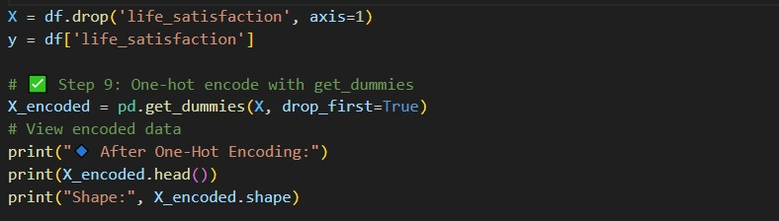
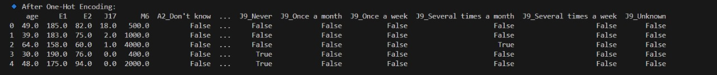
One hot encoding for categorical features
One-hot encoding successfully transformed categorical features into a numeric format suitable for machine learning. Although it increased the feature space, it preserved all category information without imposing ordinal relationships, making it ideal for models sensitive to categorical variables.
Observation

Slide 14
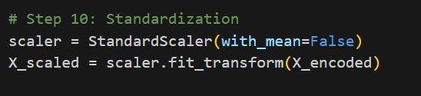
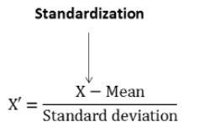
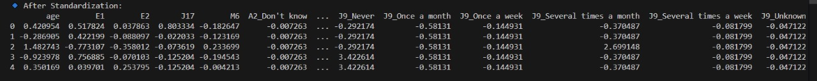
Normalization / Standardization for numerical
Standardization was applied to numerical features to ensure all values are on a similar scale. This process centered the data around zero with unit variance, which is especially important for distance-based models like SVM. It helps improve model convergence and ensures fair weight distribution across features.

Slide 15
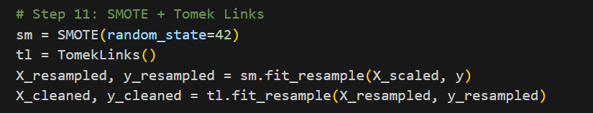
Balancing technique
Observation
Balancing was performed using SMOTE followed by Tomek Links to handle class imbalance in the target variable. SMOTE generated synthetic samples for minority classes, while Tomek Links helped clean overlapping instances. This combination improved class representation, reduced bias toward majority classes, and supported better generalization in model performance.

Slide 16
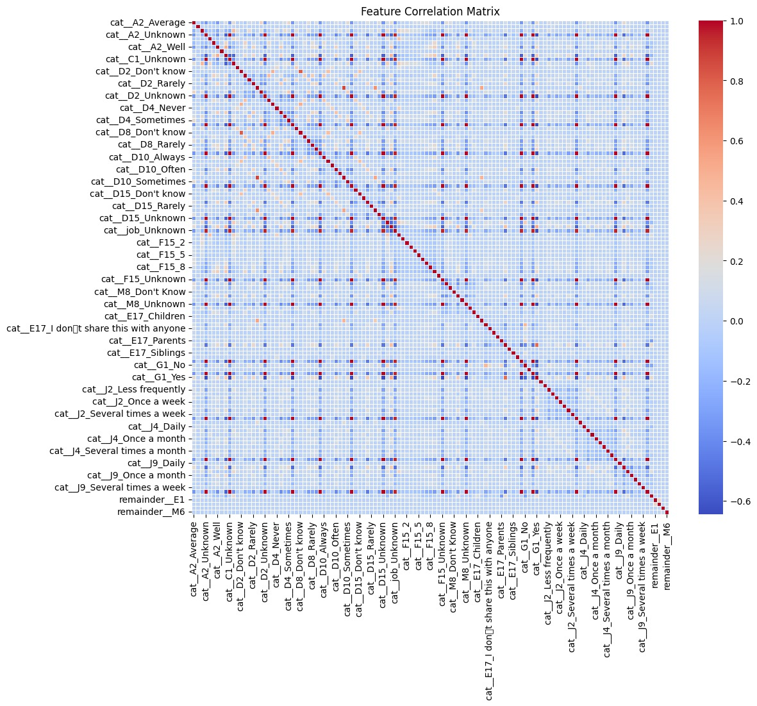
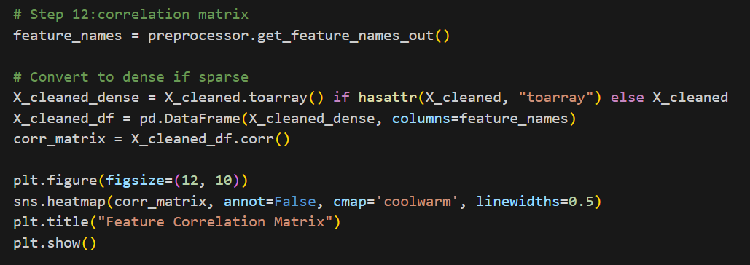
Correlation Matrix
Since the dataset contains many categorical features, traditional correlation analysis (like Pearson) is less effective. Instead, PCA was used to understand feature relationships. The explained variance plot shows that a few components capture most of the variability, indicating potential redundancy among features. This helps in dimensionality reduction and improving model efficiency. Missing values were found primarily in the 'job' feature. These were handled using simple imputation by replacing nulls with the category "Unknown". This approach preserves all records without data loss and maintains model readiness while ensuring the integrity of categorical analysis.

Slide 17
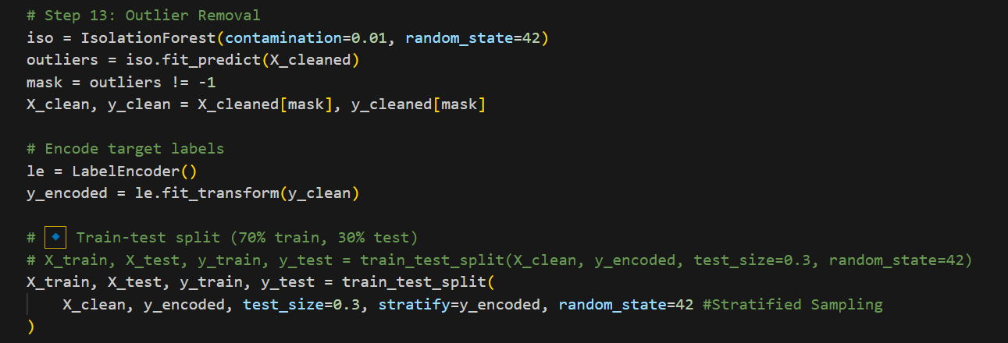
Outlier removal
Outlier detection using Isolation Forest identified a small percentage of data points as anomalies. Removing these outliers helps reduce noise and potential distortion in model training. This step enhances overall model stability and accuracy, especially in datasets with sensitive numerical features like age.

Slide 18
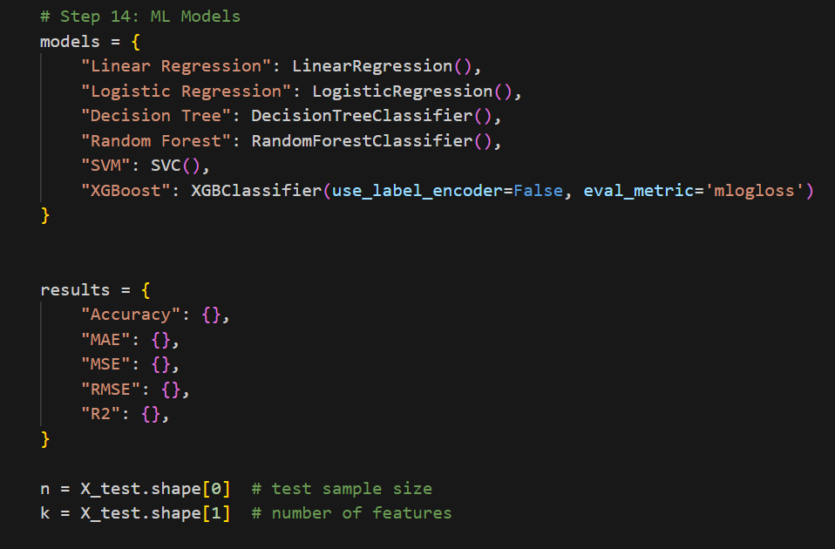
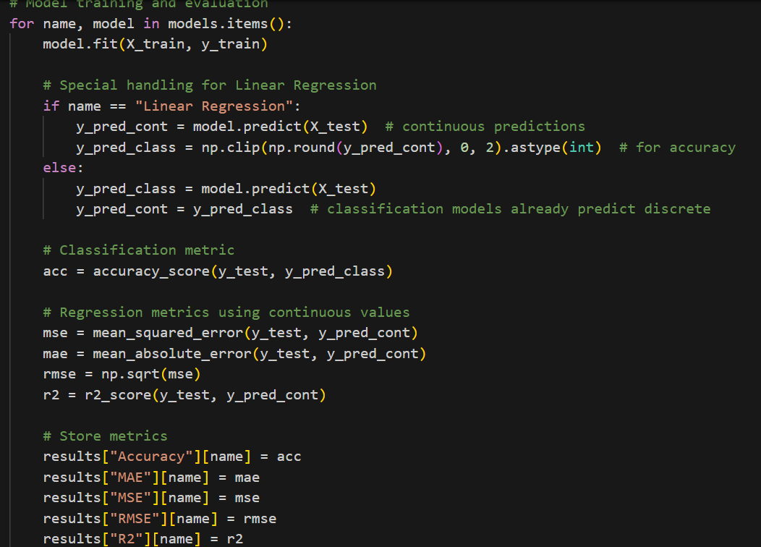
ML Model

Slide 19
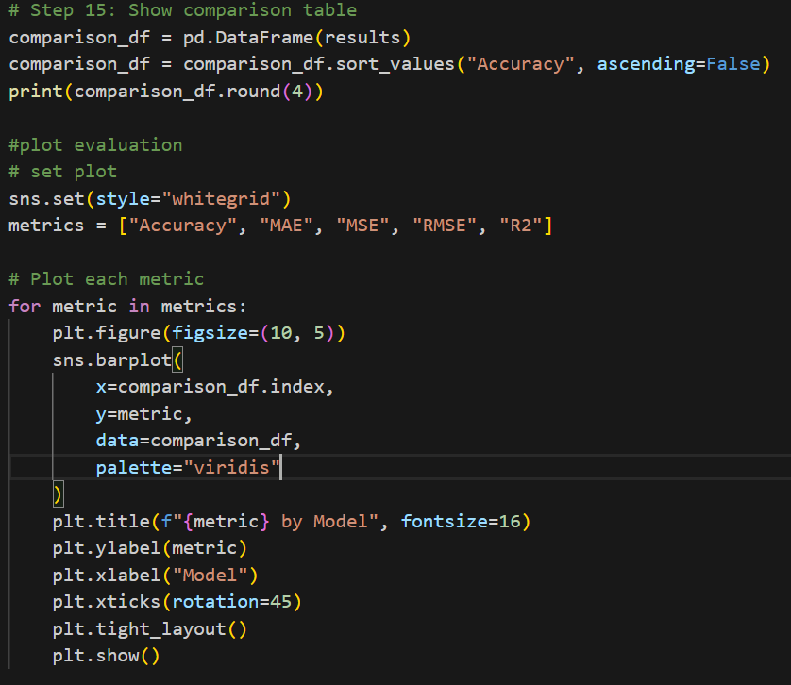
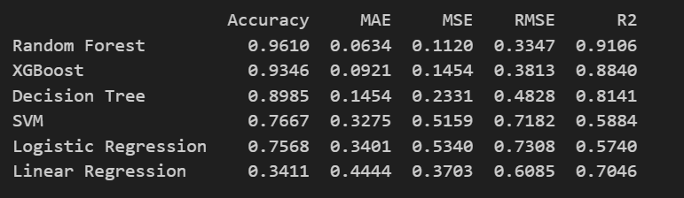
Comparison table

Slide 20
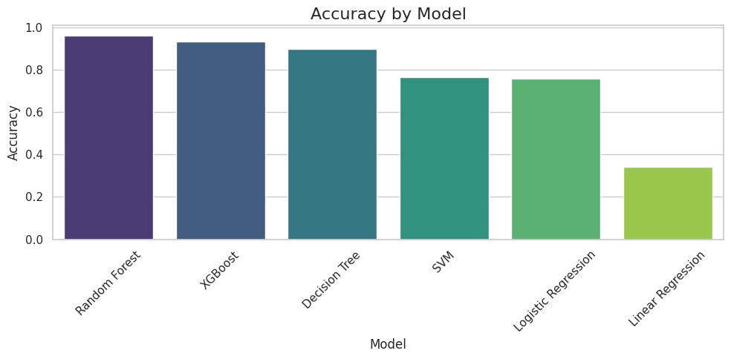
Accuracy by Model

Slide 21
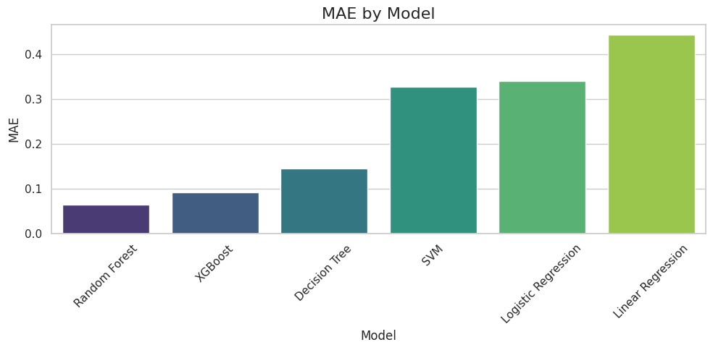
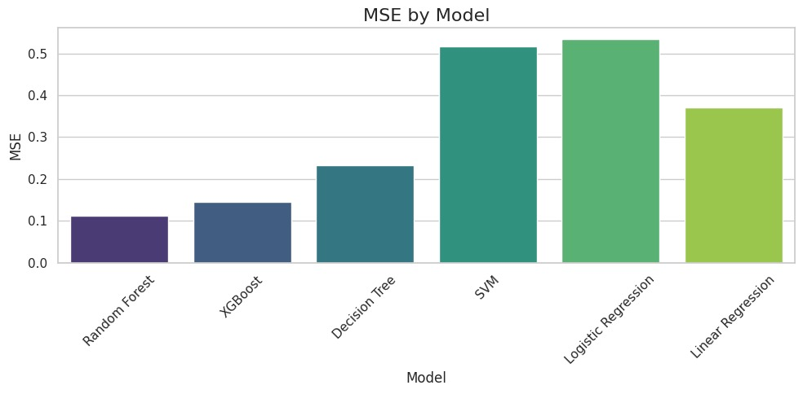
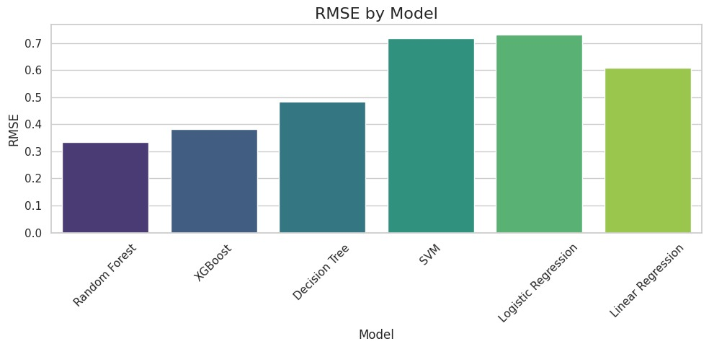
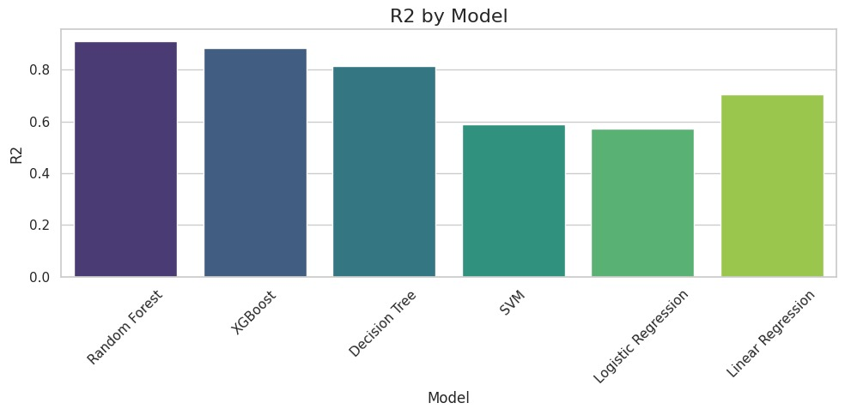
Cost Function and R2 Score

Slide 22
Comparison with Paper
Aspect | Your Project | Published Paper (Heliyon 2024)
Dataset | 18,958 entries | 19,000 from SHILD (Denmark govt. survey)
Feature Selection | PCA & manual selection | RFECV (Recursive Feature Elimination with Cross Validation)
Missing Data Handling | Simple imputation ("Unknown" for job) | Iterative imputation (Bayesian Ridge)
Encoding | One-hot encoding | Ordinal encoding
Outlier Handling | Isolation Forest | Z-score based replacement with median
Class Balancing | SMOTE + Tomek Links | SMOTE + Undersampling (dual strategy)
ML Models Used | Random forest, XGBoost, Decision tree, svm, Logistic Regration. | RF, GB, XGBoost, AdaBoost, LGB, Logistic Regression, SVC, Naive Bayes
Ensemble Model | Mentioned (comparison table shown) | RF + GB + LGB ensemble with tuning
Evaluation Metrics | Accuracy, R², Cost Function | Accuracy, F1, Precision, Recall, ROC
Best Accuracy (ML) | Random forest (96.10%) | 93.80% (RF), 93.60% (Ensemble)

Slide 23
Novelty
✔️ LLM-based Text Embedding: Process open-ended user responses via LLM (BERT/GPT) embeddings and add them to the ML model features.
✔️ LLM-generated Human Explanation: Use GPT to provide human-friendly natural language explanations for predictions.
✔️ User Feedback Loop: Streamlit app collects user feedback on prediction correctness to guide future model refinement, making the model self-improving and interactive.

Slide 24
Summary
The project titled "Predicting Life Satisfaction using Machine Learning" focuses on analyzing and forecasting individuals' life satisfaction levels using a publicly available dataset from Kaggle containing 18,958 records. The team conducted thorough data preprocessing, including handling missing values (especially in the ‘job’ feature), applying one-hot encoding for categorical variables, standardizing numerical features, and addressing class imbalance using SMOTE and Tomek Links. Exploratory data analysis revealed patterns such as a dominant age group of 20–30 years and skewed distributions in categorical features, which may influence model performance. Advanced techniques like PCA were used to manage the high dimensionality from categorical features, while Isolation Forest helped identify and remove outliers. Various machine learning models were developed and compared based on accuracy, cost function, and R² score to evaluate their effectiveness. Overall, the project highlights a data-driven approach to understanding the complex factors influencing life satisfaction.

Slide 25
Thank YOU!

